Slide 1
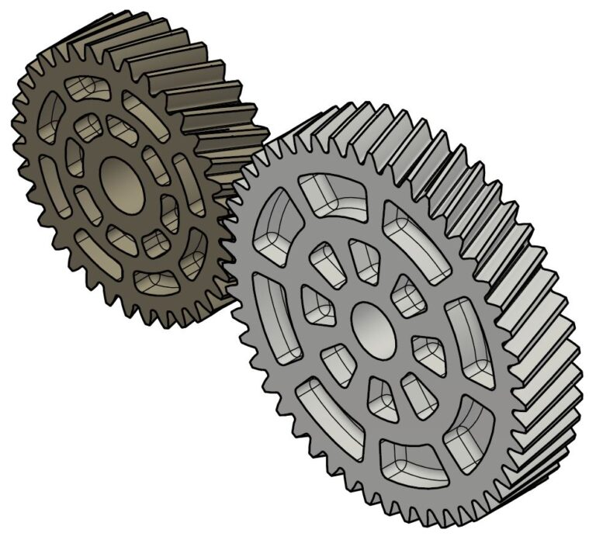
Kinematics and Dynamics
Day 04 | MP 3010
Gears
Gear Trains

Slide 2
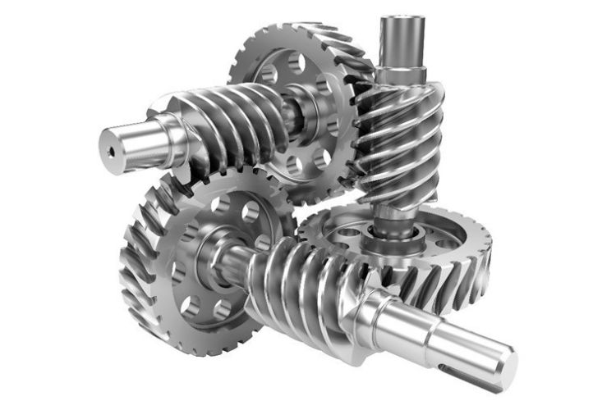
Gears
Section 1

Slide 3
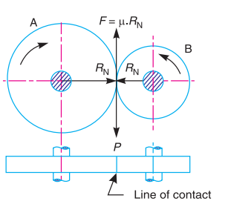
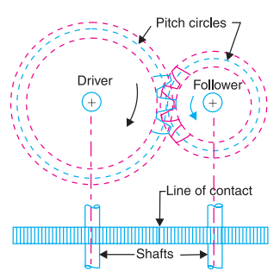
Types of Gears
Friction Wheels
Toothed Wheels

Slide 4
Advantages and Disadvantages of Gear Drive
Advantages
1. It transmits exact velocity ratio.
2. It may be used to transmit large power.
3. It has high efficiency.
4. It has reliable service.
5. It has compact layout.
Disadvantages
1. The manufacture of gears require special tools and equipment.
2. The error in cutting teeth may cause vibrations and noise during operation.

Slide 5
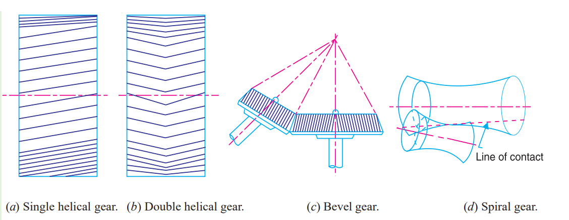

Classification of toothed gears
1. According to the position of axes of the shafts.
The axes of the two shafts between which the motion is to be transmitted, may be;
Parallel
(b) Intersecting
(c) Non-intersecting and non-parallel.
Parallel Intersecting Non –intersecting and non parallel

Slide 6
Classification of toothed gears
2. According to the peripheral velocity of the gears. The gears, according to the peripheral velocity of the gears may be classified as :
Low velocity
(b) Medium velocity
(c) High velocity.

Slide 7
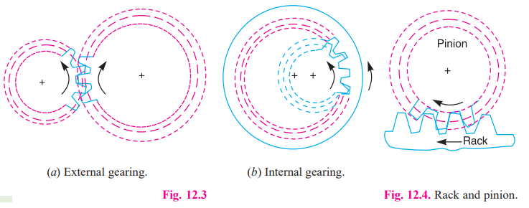
Classification of toothed gears
3. According to the type of gearing. The gears, according to the type of gearing may be classified as :
External gearing
(b) Internal gearing
(c) Rack and pinion

Slide 8
Classification of toothed gears
4. According to position of teeth on the gear surface. The teeth on the gear surface may be
(a) straight
(b) Inclined
(c) curved.

Slide 9
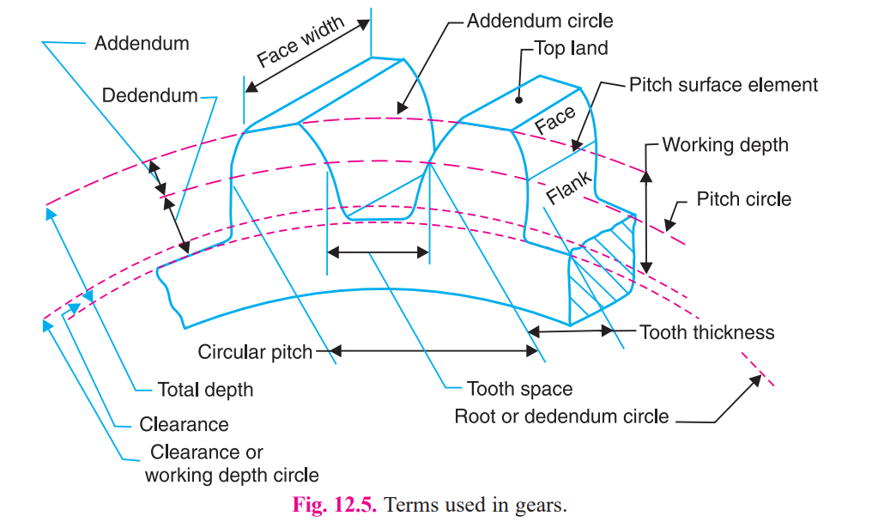
Terms Used in Gears

Slide 10
1. Pitch circle
It is an imaginary circle which by pure rolling action, would give the same motion as the actual gear.
2. Pitch circle diameter.
It is the diameter of the pitch circle. The size of the gear is usually specified by the pitch circle diameter. It is also known as pitch diameter.
3. Pitch point.
It is a common point of contact between two pitch circles.
4. Pitch surface.
It is the surface of the rolling discs which the meshing gears have replaced at the pitch circle.

Slide 11
5. Pressure angle or angle of obliquity. It is the angle between the common normal to two gear teeth at the point of contact and the common tangent at the pitch point. It is usually denoted by φ. The standard pressure angles are 14.5 ° and 20°.
6. Addendum. It is the radial distance of a tooth from the pitch circle to the top of the tooth.
7. Dedendum. It is the radial distance of a tooth from the pitch circle to the bottom of the tooth.
8. Addendum circle. It is the circle drawn through the top of the teeth and is concentric with the pitch circle.
9. Dedendum circle. It is the circle drawn through the bottom of the teeth. It is also called root circle.
Note : Root circle diameter = Pitch circle diameter × cos φ, where φ is the pressure angle.

Slide 12
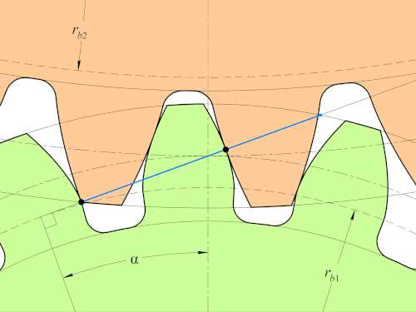

Slide 13
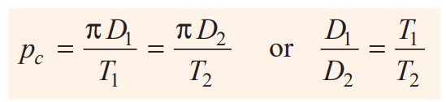
Circular Pitch - p_{c}
It is the distance measured on the circumference of the pitch circle from a point of one tooth to the corresponding point on the next tooth.
Mathematically,
Circular pitch, p_{c} = π D/T
Where;
D = Diameter of the pitch circle
T = Number of teeth on the wheel.
Note : If D₁ and D₂ are the diameters of the two meshing gears having the teeth T₁ and T₂ respectively, then for them to mesh correctly,

Slide 14
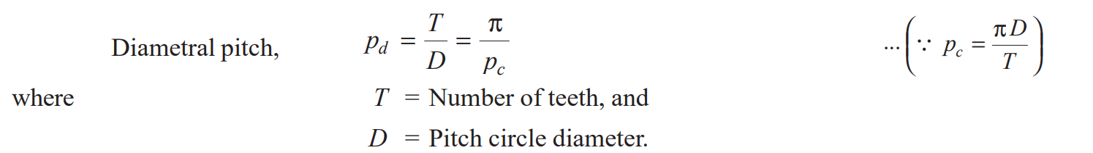
Diametral Pitch
It is the ratio of number of teeth to the pitch circle diameter in millimeters. It is denoted by p_{d} .
Mathematically,

Slide 15
Module
It is the ratio of the pitch circle diameter in millimeters to the number of teeth. It is usually denoted by m.
Mathematically,
Module, m = D /T

Slide 16
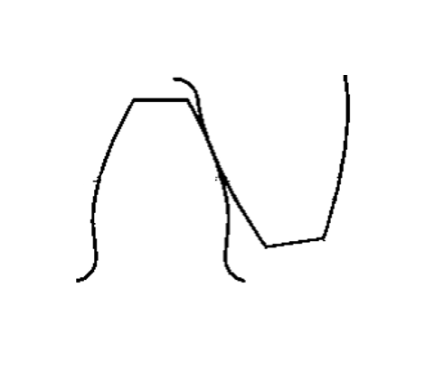
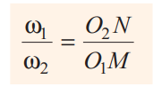
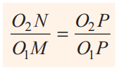
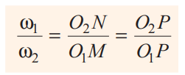

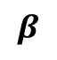
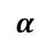
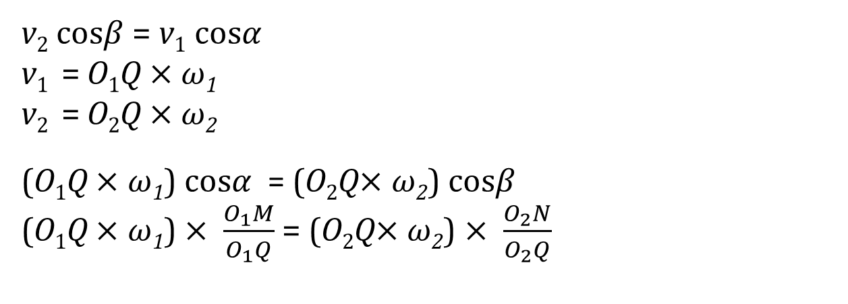
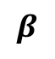
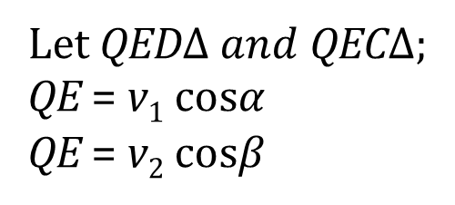
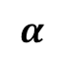

Law of Gearing
O₂
Let QED$∆ and$ QEC$∆$;
QE = v₁ cos$α$
QE = v₂ cos$β$
$$β$$
v₂ cos$β$= v₁ cos$α$
v₁ = O₁Q $×$ $ω$₁
v₂ = O₂Q $×$ $ω$₂
(O₁Q $×$ $ω$₁) cos$α$ = (O₂Q$×$ $ω$₂) cos$β$
(O₁Q $×$ $ω$₁) $× \frac{O_{1}M}{O_{1}Q}$ = (O₂Q$×$ $ω$₂) $× \frac{O_{2}N}{O_{2}Q}$
$ω$₂
E
N
P
C
$$α$$
v₁
Q
$$β$$
M
D
v₂
$$α$$
$ω$₁
Also, from similar triangles
O₁MP and O₂NP,
O₁

Slide 17
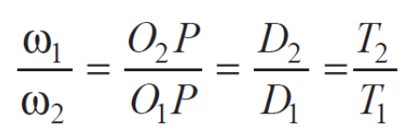
Law of Gearing
The common normal at the point of contact between a pair of teeth must always pass through the pitch point.
Wheels 1 and 2 having teeth 𝑇₁ and 𝑇₂ and pitch circle diameters 𝐷₁ and 𝐷₂ .

Slide 18
Form of teeth in gears
Cycloidal teeth
Cycloid - curve traced by a point on the circumference of a circle which rolls without slipping on a fixed straight line.
Epicycloid - curve traced by a point on the circumference of a circle which rolls without slipping on the outside of a fixed circle.
Hypocycloid - curve traced by a point on the circumference of a circle which rolls without slipping on the inside of a fixed circle.

Slide 19
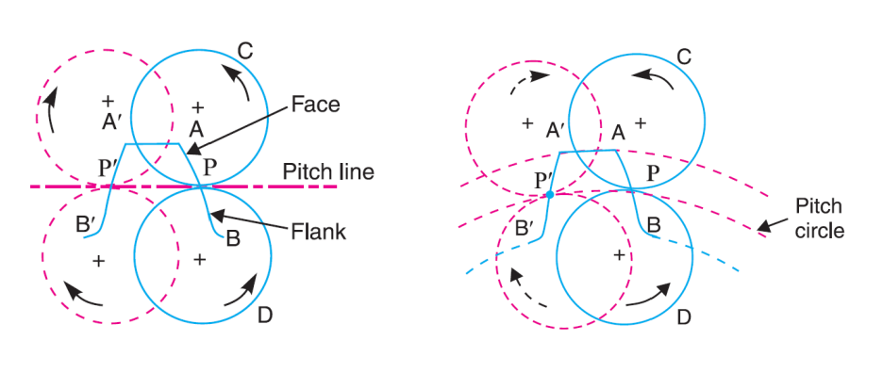
Construction of cycloidal teeth of a gear.

Slide 20
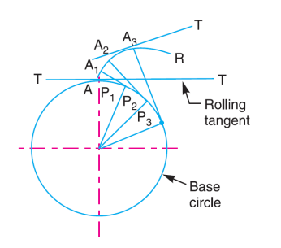
Involute Teeth
An involute of a circle is a plane curve generated by a point on a taut string which in unwrapped from a reel as shown. In toothed wheels, the circle is known as base circle.
Normal at any point of an involute is a tangent to the circle.

Slide 21
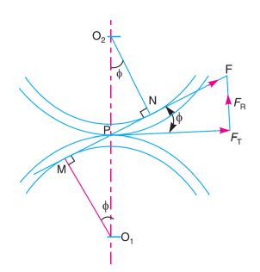
Torque exerted on the gear shaft
𝐹 is maximum tooth pressure.
Tangential force,
𝐹_{𝑇} = 𝐹𝑐𝑜𝑠 𝜙
Radial or normal force,
𝐹_{𝑅} = 𝐹𝑠𝑖𝑛 𝜙
𝜙 – Pressure angle
Torque exerted on the gear shaft;
𝜏 = 𝐹𝑇 × 𝑟
Where, 𝑟 - the pitch circle radius of the gear.

Slide 22
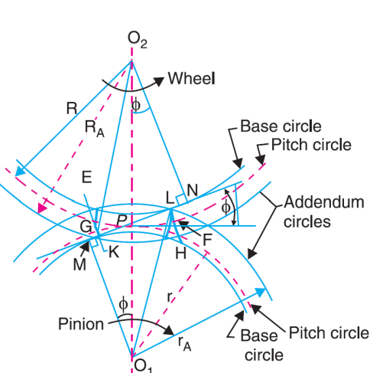
Length of Path of Contact
Length of path of contact (KL) is the length of common normal cutoff by the addendum circles of the wheel and the pinion.
KL = KP + PL
KP - Path of approach
PL – Path of recess
𝑟_{𝐴} = 𝑂₁𝐿 − Radius of addendum circle of pinion
𝑅_{𝐴} = 𝑂₂𝐾 − Radius of addendum circle of wheel
𝑟 = 𝑂₁𝑃 − Radius of pitch circle of pinion
𝑅 = 𝑂₂𝑃 − Radius of pitch circle of wheel

Slide 23
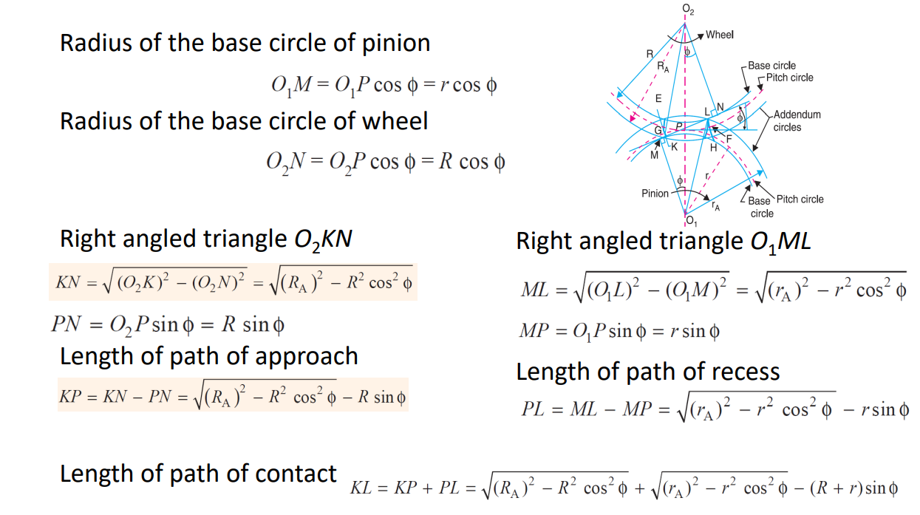

Slide 24
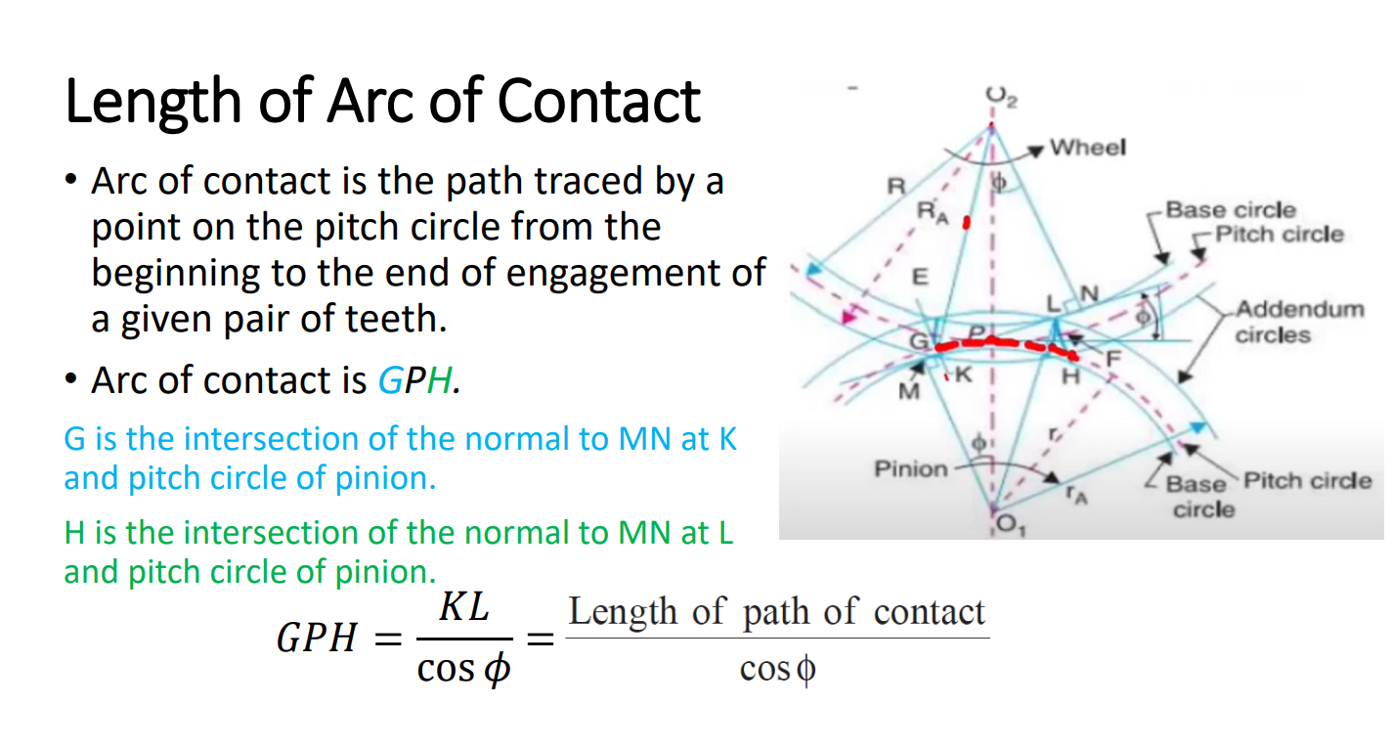

Slide 25
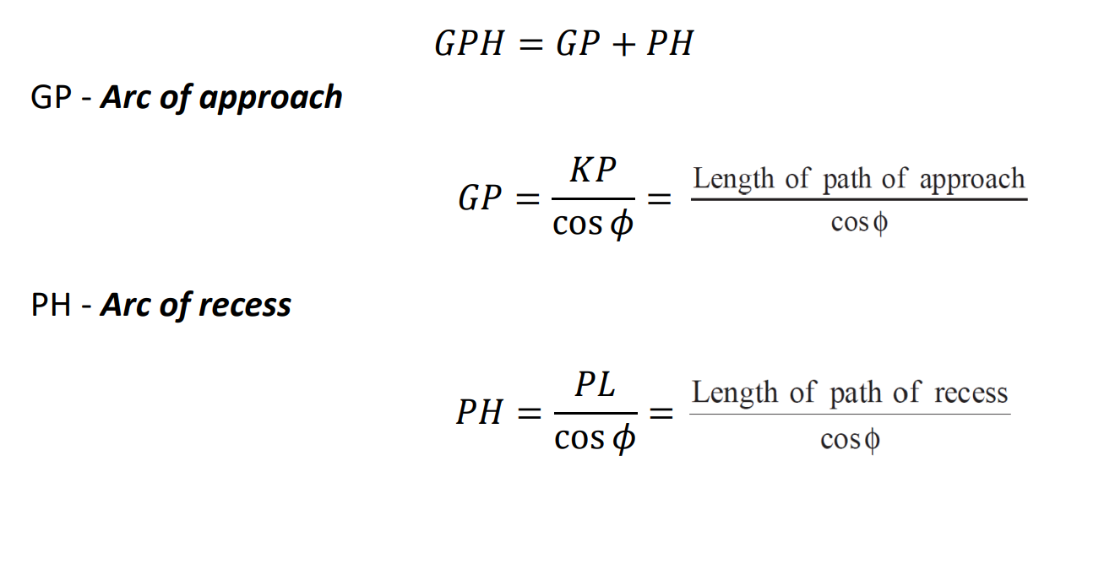

Slide 26
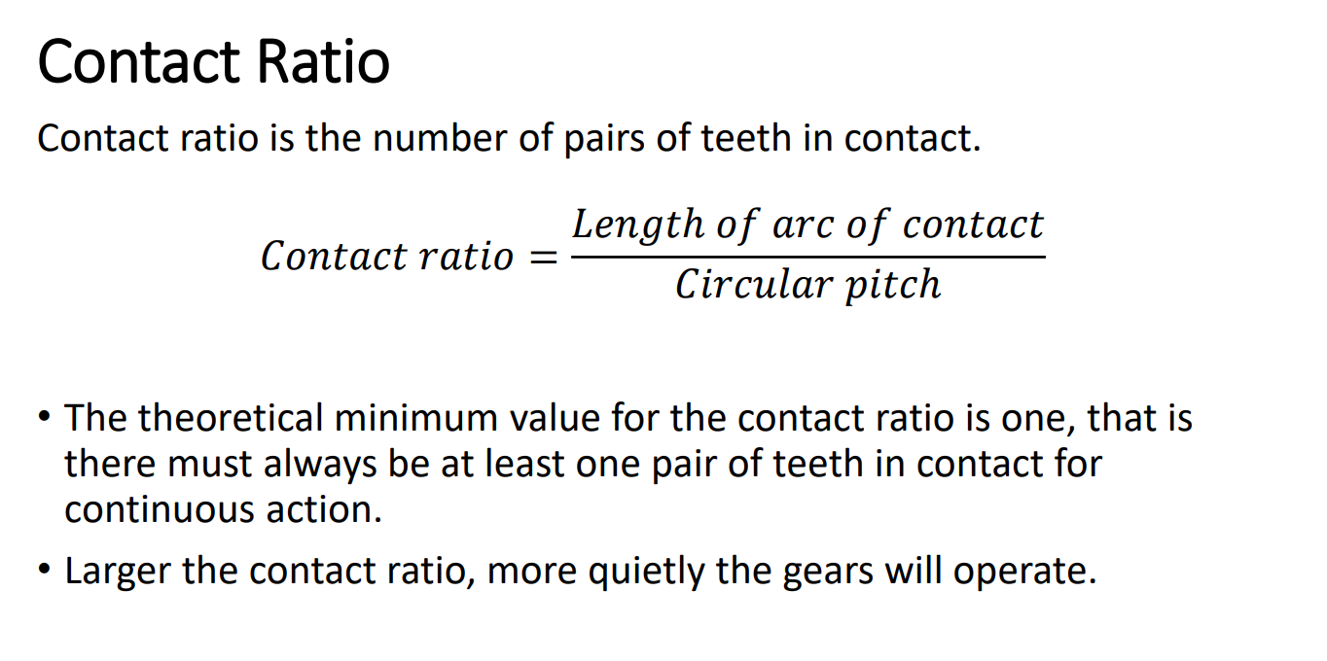

Slide 27
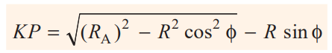
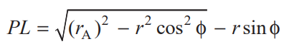
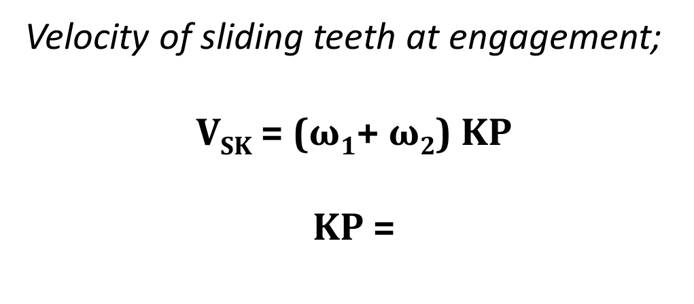
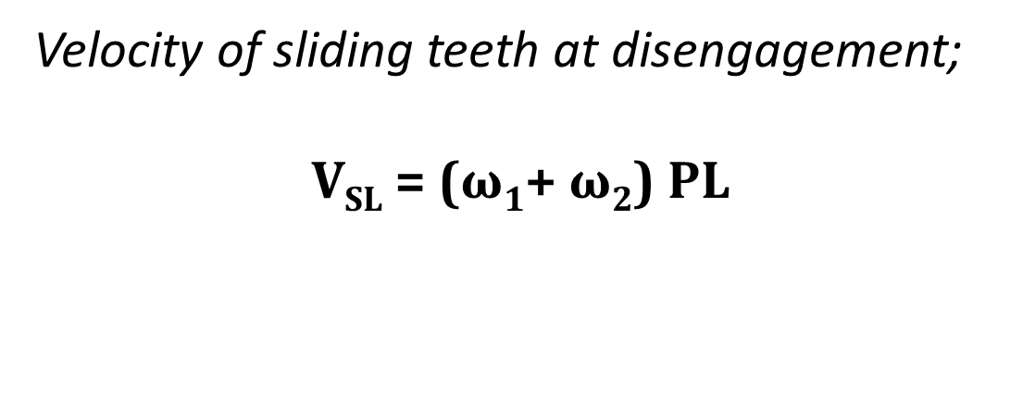
Velocity of Sliding of Teeth
Velocity of sliding teeth at engagement;
V_{SK} = ($ω$₁+ $ω$₂) KP
KP =
Velocity of sliding teeth at disengagement;
V_{SL} = ($ω$₁+ $ω$₂) PL

Slide 28
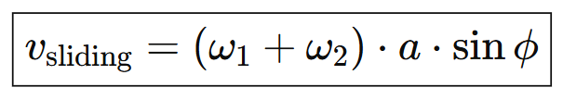
Velocity of Sliding of Teeth
For equal addendum gears;

Slide 29
Questions
1. The pitch circle diameter of the smaller of the two spur wheels which mesh externally and have involute teeth is 100 mm. The number of teeth are 16 and 32. The pressure angle is 20° and the addendum is 0.32 of the circular pitch. Find the length of the path of contact of the pair of teeth.
[Ans. 29.36 mm]
2. A pair of gears, having 40 and 30 teeth respectively are of 25° involute form. The addendum length is 5 mm and the module pitch is 2.5 mm. If the smaller wheel is the driver and rotates at 1500 r.p.m., find the velocity of sliding at the point of engagement and at the point of disengagement.
[Ans. 2.8 m/s ; 2.66 m/s]

Slide 30
3. Two gears of module 4mm have 24 and 33 teeth. The pressure angle is 20° and each gear has a standard addendum of one module. Find the length of arc of contact and the maximum velocity of sliding if the pinion rotates at 120 r.p.m.
[Ans. 20.58 mm ; 0.2147 m/s]
4. The number of teeth in gears 1 and 2 are 60 and 40 ; module = 3 mm ; pressure angle = 20° and addendum = 0.318 of the circular pitch. Determine the velocity of sliding when the contact is at the tip of the teeth of gear 2 and the gear 2 rotates at 800 r.p.m.
[Ans. 1.06 m/s]
5. Two spur gears of 24 teeth and 36 teeth of 8 mm module and 20° pressure angle are in mesh. Addendum of each gear is 7.5 mm. The teeth are of involute form. Determine : 1. the angle through which the pinion turns while any pair of teeth are in contact, and 2. the velocity of sliding between the teeth when the contact on the pinion is at a radius of 102 mm. The speed of the pinion is 450 r.p.m.
[Ans. 20.36°, 1.16 m/s]

Slide 31
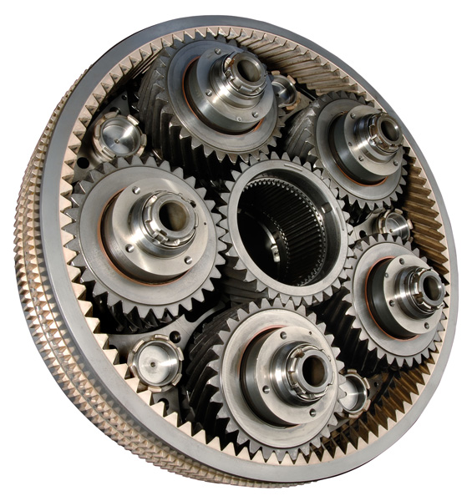
Gear Trains
Section 2

Slide 32
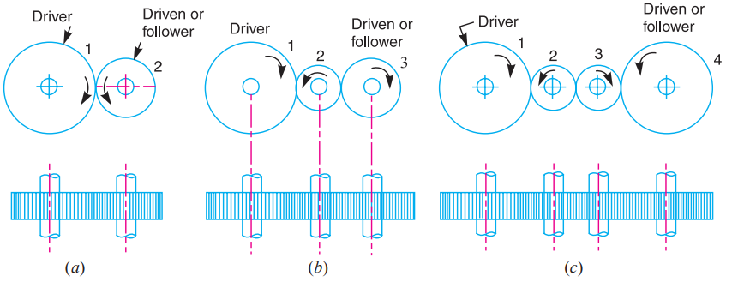
Types of Gear Trains
Following are the different types of gear trains, depending upon the arrangement of wheels :
1. Simple gear train
2. Compound gear train
3. Reverted gear train
4. Epicyclic gear

Slide 33
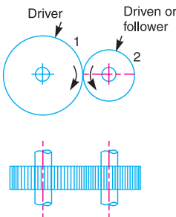
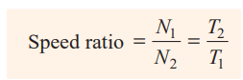
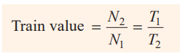
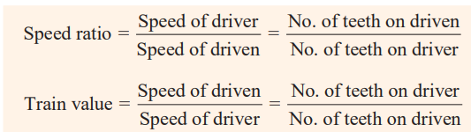
Let;
N₁ = Speed of gear 1(or driver) in r.p.m.
N₂ = Speed of gear 2 (or driven or follower) in r.p.m.
T₁ = Number of teeth on gear 1
T₂ = Number of teeth on gear 2.

Slide 34
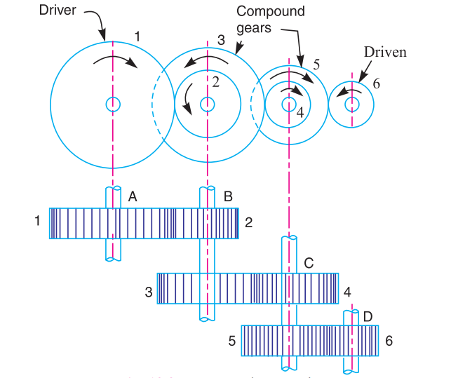
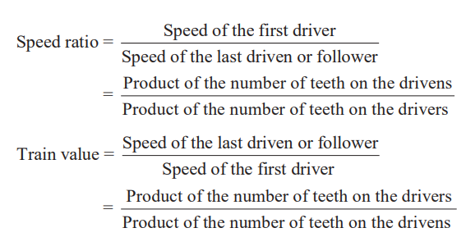
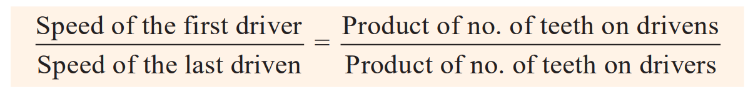
Compound Gear Trains

Slide 35
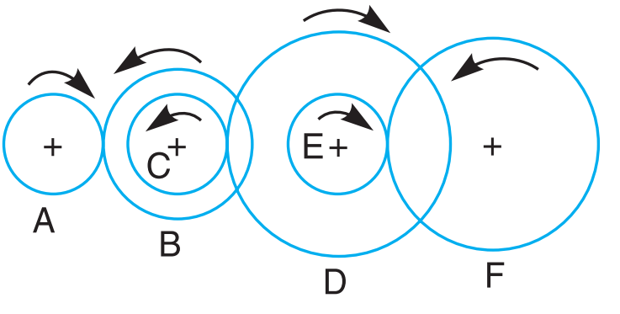
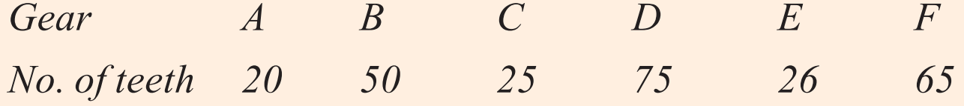
Example
The gearing of a machine tool is shown in Figure. The motor shaft is connected to gear A and rotates at 975 r.p.m. The gear wheels B, C, D and E are fixed to parallel shafts rotating together. The final gear F is fixed on the output shaft. What is the speed of gear F ? The number of teeth on each gear are as given below :

Slide 36
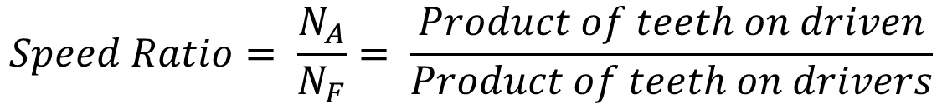
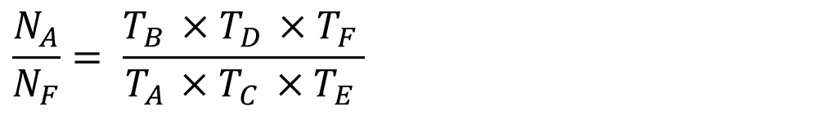
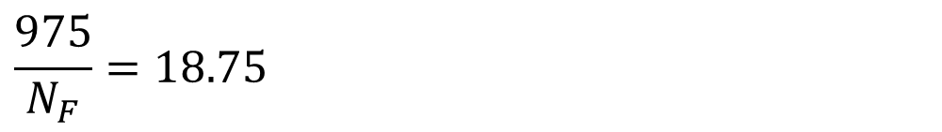
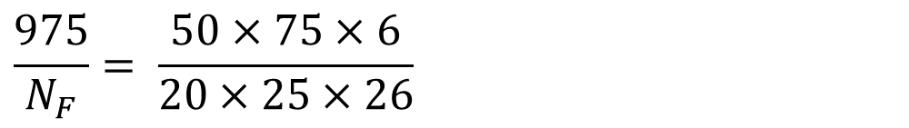
$$Speed Ratio= \frac{N_{A}}{N_{F}}= \frac{Product of teeth on driven}{Product of teeth on drivers}$$
$$\frac{N_{A}}{N_{F}}= \frac{T_{B }×T_{D }×T_{F }}{T_{A }×T_{C }×T_{E }}$$
Driver | Driven
A | B
C | D
E | F
$$\frac{975}{N_{F}}= \frac{50×75×6}{20×25×26}$$
$$\frac{975}{N_{F}}=\text{18.75}$$
$$N_{F}=\text{52 }\text{r}\text{. }\text{p}\text{. }\text{m}\text{.}$$

Slide 37
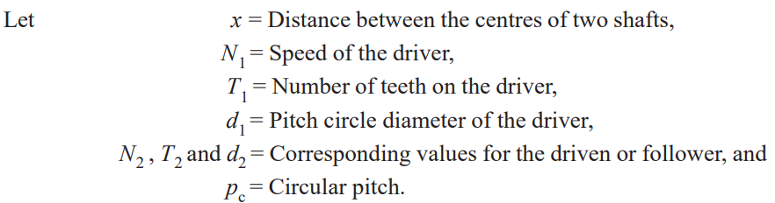


Design of Spur Gears
The spur gears are to be designed for the given velocity ratio and distance between the center of their shafts.

Slide 38

Reverted Gear Train
When the axes of the first gear and the last gear are co-axial, then the gear train is known as reverted gear train.
Used in speed reducers, clocks and machine tools.

Slide 39


Slide 40


Example
Input shaft A and the output shaft B are coincident and are geared together through a parallel counter shaft C. The wheels connecting shafts A and C have a module of 2 mm and those connecting C and B have a module of 3.5 mm. Speed of output shaft has to be less than 1/10 that of shaft A. if the two pinions have each 24 teeth, determine;
i. Suitable teeth for other gear wheels
ii. Actual speed ratio
iii. The corresponding distance of shaft C from A.

Slide 41




i)
Module of gears between A and C: m₁=2 mm
Module of gears between C and B: m₂=3.5 mm
Number of teeth on both pinions (on A and C): T₁=T₃=24
Required speed ratio: Output speed < 1/10 of input speed
Let:
Gear 1: on shaft A (driver), pinion, T₁=24, m₁=2
Gear 2: on shaft C (driven by A), wheel, T₂, m₁=2
Gear 3: on shaft C (driver for B), pinion, T₃=24, m₂=3.5
Gear 4: on shaft B (driven), wheel, T₄, m₂=3.5
Gear Pair: 1 (driver) to 2(driven) and 3(driver) to 4(driven)
$$Speed Ratio= \frac{N_{A}}{N_{F}}= \frac{Product of teeth on driven}{Product of teeth on drivers}$$
$$Speed Ratio= \frac{\text{T}\text{2}\text{T}\text{4}}{\text{T}\text{1}\text{T}\text{3}}>10$$
$$\frac{\text{T}\text{2}\text{T}\text{4}}{\text{24}×24}>10$$
$\text{T}\text{2}\text{T}\text{4} >5760$ → ❶

Slide 42




r₁ + r₂ = r₃ + r₄
$$\frac{m_{1}T_{1}}{2}+\frac{m_{1}T_{2}}{2}=\frac{m_{2}T_{3}}{2}+\frac{m_{2}T_{4}}{2}$$
2(24 + $T_{2}$) = 3.5(24 + $T_{4}$)
48 + 2 $T_{2}$ = 84 + 3.5 $T_{4}$
2 $T_{2}$ - 3.5 $T_{4}$ = 36 → ❷
$\text{T}\text{2}$ = $\frac{5761}{T_{4}}$ → from equation 1
$\text{T}\text{2}$ = 110
$\text{T}\text{4 }$ = 53

Slide 43




ii)
$$Speed Ratio= \frac{Product of teeth on driven}{Product of teeth on drivers}$$
$$Speed Ratio= \frac{\text{53} ×110}{\text{2}\text{4} ×24}$$
$Actual Speed Ratio=10.1215$
iii)
d = r₁ + r₂
d = $\frac{m_{1}T_{1}}{2}+\frac{m_{1}T_{2}}{2}$
d = T₁ + T₂
d = 110 +24 = 134mm

Slide 44

Epicyclic Gear Trains
If the axes of the shafts, the gears are mounted, may move relative to a fixed axis is known as Simple epicyclic gear train.

Slide 45
Velocity Ratios of Epicyclic Gear Train
Tabular Method
Consider an epicyclic gear train as shown in Figure.
Let T_{A} = Number of teeth on gear A, and T_{B} = Number of teeth on gear B.

Slide 46

Steps for tabular method:
Governing Equations

Slide 47

In an epicyclic gear train, an arm carries two gears A and B having 36 and 45 teeth respectively. If the arm rotates at 150 r.p.m. in the anticlockwise direction about the center of the gear A which is fixed, determine the speed of gear B. If the gear A instead of being fixed, makes 300 r.p.m. in the clockwise direction, what will be the speed of gear B ?

Slide 48

Tabular Method
Step No. | Condition of Motion | Revolution of elements
 |  | Gear A | Gear B | Arm C
1 | Arm fixed, +1 for Gear A | +1 | - $\frac{T_{A}}{T_{B}}$ | 0
2 | Arm fixed, +x for Gear A | +x | -x$\frac{T_{A}}{T_{B}}$ | 0
3 | +y for all Gears | +y | +y | +y
4 | Total motion | x+y | y - x$\frac{T_{A}}{T_{B}}$ | +y

Slide 49


If the Gear A is fixed, x+y = 0;
T_{A} = 36 ; T_{B} = 45 ;
N_{C} = 150 r.p.m. (anticlockwise)
So, y = 150 r.p.m.
x = -150 r.p.m.
Thus, speed of Gear B = y - x$\frac{T_{A}}{T_{B}}$
= 150 + 150$×\frac{36}{45}$
= +270 r.p.m. (Anticlockwise)
Speed of gear B when gear A makes 300 r.p.m. clockwise;
x+y = -300
y = 150
x = -450
Thus, speed of Gear B = y - x$\frac{T_{A}}{T_{B}}$
= 150 + 450$×\frac{36}{45}$
= +510 r.p.m. (Anticlockwise)

Slide 50


Slide 51

Practice Questions

Slide 52

In a reverted epicyclic gear train, the arm A carries two gears B and C and a compound gear D - E. The gear B meshes with gear E and the gear C meshes with gear D. The number of teeth on gears B, C and D are 75, 30 and 90 respectively. Find the speed and direction of gear C when gear B is fixed and the arm A makes 100 r.p.m. clockwise.

Slide 53

An epicyclic gear consists of three gears A, B and C as shown in Figure. The gear A has 72 internal teeth and gear C has 32 external teeth. The gear B meshes with both A and C and is carried on an arm EF which rotates about the centre of A at 18 r.p.m.. If the gear A is fixed, determine the speed of gears B and C.

Slide 54

An epicyclic train of gears is arranged as shown in Figure. How many revolutions does the arm, to which the pinions B and C are attached, make :
when A makes one revolution clockwise and D makes half a revolution anticlockwise, and
when A makes one revolution clockwise and D is stationary ?
The number of teeth on the gears A and D are 40 and 90 respectively.

Slide 55
In an epicyclic gear train, the internal wheels A and B and compound wheels C and D rotate independently about axis O. The wheels E and F rotate on pins fixed to the arm G. E gears with A and C and F gears with B and D. All the wheels have the same module and the number of teeth are : TC = 28; TD = 26; TE = TF = 18.
Sketch the arrangement
Find the number of teeth on A and B
If the arm G makes 100 r.p.m. clockwise and A is fixed, find the speed of B
If the arm G makes 100 r.p.m. clockwise and wheel A makes 10 r.p.m. counter clockwise ; find the speed of wheel B.

Slide 56

In an epicyclic gear of the ‘sun and planet’ type shown in Figure, the pitch circle diameter of the internally toothed ring is to be 224 mm and the module 4 mm. When the ring D is stationary, the spider A, which carries three planet wheels C of equal size, is to make one revolution in the same sense as the sunwheel B for every five revolutions of the driving spindle carrying the sunwheel B. Determine suitable numbers of teeth for all the wheels

Slide 57

Two shafts A and B are co-axial. A gear C (50 teeth) is rigidly mounted on shaft A. A compound gear D-E gears with C and an internal gear G. D has 20 teeth and gears with C and E has 35 teeth and gears with an internal gear G. The gear G is fixed and is concentric with the shaft axis. The compound gear D-E is mounted on a pin which projects from an arm keyed to the shaft B. Sketch the arrangement and find the number of teeth on internal gear G assuming that all gears have the same module. If the shaft A rotates at 110 r.p.m., find the speed of shaft B.

Slide 58

Figure shows diagrammatically a compound epicyclic gear train. Wheels A , D and E are free to rotate independently on spindle O, while B and C are compound and rotate together on spindle P, on the end of arm OP. All the teeth on different wheels have the same module. A has 12 teeth, B has 30 teeth and C has 14 teeth cut externally. Find the number of teeth on wheels D and E which are cut internally. If the wheel A is driven clockwise at 1 r.p.s. while D is driven counter clockwise at 5 r.p.s., determine the magnitude and direction of the angular velocities of arm OP and wheel E.

Slide 59

An internal wheel B with 80 teeth is keyed to a shaft F. A fixed internal wheel C with 82 teeth is concentric with B. A compound wheel D-E gears with the two internal wheels; D has 28 teeth and gears with C while E gears with B. The compound wheels revolve freely on a pin which projects from a disc keyed to a shaft A co-axial with F. If the wheels have the same pitch and the shaft A makes 800 r.p.m., what is the speed of the shaft F ? Sketch the arrangement.

Slide 60

Fig. 13.26 shows an epicyclic gear train. Pinion A has 15 teeth and is rigidly fixed to the motor shaft. The wheel B has 20 teeth and gears with A and also with the annular fixed wheel E. Pinion C has 15 teeth and is integral with B (B, C being a compound gear wheel). Gear C meshes with annular wheel D, which is keyed to the machine shaft. The arm rotates about the same shaft on which A is fixed and carries the compound wheel B, C. If the motor runs at 1000 r.p.m., find the speed of the machine shaft. Find the torque exerted on the machine shaft, if the motor develops a torque of 100 N-m.

Slide 61

An epicyclic gear train consists of a sun wheel S, a stationary internal gear E and three identical planet wheels P carried on a star- shaped planet carrier C. The size of different toothed wheels are such that the planet carrier C rotates at 1/5th of the speed of the sunwheel S. The minimum number of teeth on any wheel is 16. The driving torque on the sun wheel is 100 N-m. Determine : 1. number of teeth on different wheels of the train, and 2. torque necessary to keep the internal gear stationary

Slide 62

In an epicyclic gear train of the ‘sun and planet type’ as shown in Fig. 13.41, the pitch circle diameter of the internally toothed ring D is to be 216 mm and the module 4 mm. When the ring D is stationary, the spider A, which carries three planet wheels C of equal size, is to make one revolution in the same sense as the sun wheel B for every five revolutions of the driving spindle carrying the sunwheel B. Determine suitable number of teeth for all the wheels and the exact diameter of pitch circle of the ring.
[Ans. TB = 14 , TC = 21 , TD = 56 ; 224 mm]

Slide 63
References: Theory of Machines by Khurmi

